Slide 1

User
code to Develop a RESTful API for a task manager.
Utilize Express for routing and middleware.
What is Bcrypt. How to use it to hash passwords - DEV Community
code to develop Authentication System using Express, Implement middleware for authentication and authorization. Use different Express route methods for user registration, login, and logout.
code for logging middleware that logs information about the incoming request such the http methods,url and timestamp which can be helpful for debugging using expressjs(p9)
ode for implementing a rate limiting middleware to control the number of request a user can make within a specific timeframe this helps prevents abuse or unwanted traffic using expressjs and html(pj10)

Slide 2
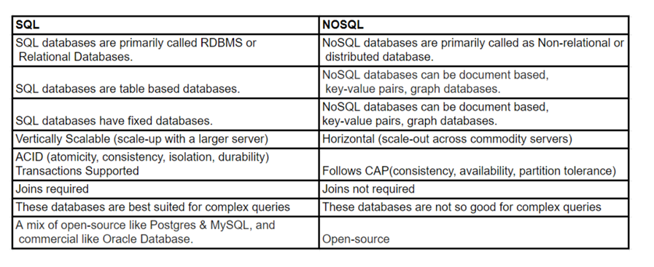
Introduction to NoSQL:- SQL stands for Structured Query Language. SQL is a standard language for storing, manipulating, and retrieving data in relational database systems. NoSQL or “non-SQL” is a non-relational database that does not require a fixed schema and is easy to scale

Slide 3
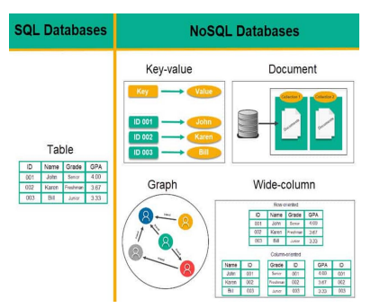
NoSQL Databases
A NoSQL database provides a mechanism for storage and retrieval of data that is modeled in means other than the tabular relations used in relational databases.
Such databases have existed since the late 1960s, but the name "NoSQL" was only coined in the early 21st century, triggered by the needs of Web 2.0 companies

Slide 4
Types of NoSQL databases
Wide-column database
A wide-column database is a NoSQL database that organizes data storage into flexible columns that can be spread across multiple servers or database nodes, using multi-dimensional mapping to reference data by column, row, and timestamp.
Some common wide-column store database examples include Apache Cassandra, ScyllaDB, Apache HBase, Google BigTable, and Microsoft Azure Cosmos DB. When it comes to a wide-column database, Cassandra is often mentioned first because of its pioneering work. But ScyllaDB is Cassandra rewritten in the C++ programming language, making it faster and more reliable. ScyllaDB has continued to evolve as a notable wide-column database Cassandra.
Key–value database
A key–value database, or key–value store, is a data storage paradigm designed for storing, retrieving, and managing associative arrays, and a data structure more commonly known today as a dictionary or hash table
Aerospike: Open-source database that is optimized for in-memory storage.
Berkeley DB: Another open-source database that is a high-performance database storage library, although it’s relatively basic.
Couchbase: Interestingly allows for text searches and SQL-style querying.

Slide 5
Graph database
Graph databases use topographical data models to store data. These databases connect specific data points (nodes) and create relationships (edges) in the form of graphs that can then be pulled by the user with queries. Nodes can represent customers, companies, or any data a company chooses to record. Edges are
formed by the database so that relationships between nodes are easily understood by the user. Businesses can utilize graph databases when they are pulling data and do not want to spend time organizing it into distinct relationships. Large enterprises may use complex queries to pull precise and in-depth information regarding their customer and user information or product tracking data, among other uses. Database administrators can scale high data values and still create usable models.
Document Based Databases
A document database has information retrieved or stored in the form of a
document or other words semi-structured database. Since they are nonrelational, so they are often referred to as NoSQL data

Slide 6
RDBMS vs MongoDB:
RDBMS has a typical schema design that shows number of tables and the relationship between these tables whereas MongoDB is document-oriented.
There is no concept of schema or relationship. Complex transactions are not supported in MongoDB because complex join operations are not available.
MongoDB allows a highly flexible and scalable document structure.
For example, one data document of a collection in MongoDB can have two fields whereas the other document in the same collection can have four.
MongoDB is faster as compared to RDBMS due to efficient indexing and storage techniques. There are a few terms that are related in both databases.
What’s called Table in RDBMS is called a Collection in MongoDB.
Similarly, a Tuple is called a Document and A Column is called a Field. MongoDB provides a default ‘_id’ (if not provided explicitly) which is a 12-byte hexadecimal number that assures the uniqueness of every document. It is similar to the Primary key in RDBMS.

Slide 7
Features of MongoDB:
Document Oriented: MongoDB stores the main subject in the minimal number of documents and not by breaking it up into multiple relational structures like RDBMS. For example, it stores all the information of a computer in a single
document called Computer and not in distinct relational structures like CPU, RAM, Hard disk, etc.
Indexing: Without indexing, a database would have to scan every document of a collection to select those that match the query which would be inefficient. So, for efficient searching Indexing is a must and MongoDB uses it to process huge volumes of data in very less time.
Scalability: MongoDB scales horizontally using sharding (partitioning data across various servers). Data is partitioned into data chunks using the shard key, and these data chunks are evenly distributed across shards that reside across
many physical servers. Also, new machines can be added to a running database.Replication and High Availability: MongoDB increases the data availability with multiple copies of data on different servers. By providing redundancy, it
protects the database from hardware failures. If one server goes down, the data can be retrieved easily from other active servers which also had the data stored on them.
Aggregation: Aggregation operations process data records and return the computed results. It is similar to the GROUPBY clause in SQL. A few aggregation expressions are sum, avg, min, max, etc

Slide 8
Where do we use MongoDB?
MongoDB is preferred over RDBMS in the following scenarios:
Big Data: If you have huge amount of data to be stored in tables, think of MongoDB before RDBMS databases. MongoDB has built-in solution for partitioning and sharing your database.
Unstable Schema: Adding a new column in RDBMS is hard whereas MongoDB is schema-less. Adding a new field does not effect old documents and will be very easy.Distributed data since multiple copies of data are stored across different servers, recovery of data is instant and safe even if there is a hardware failure.
You can create a MongoDB database in the following environments:
• MongoDB Atlas: The fully managed service for MongoDB deployments in the cloud
• MongoDB Enterprise: The subscription-based, self-managed version of MongoDB
• MongoDB Community: The source-available, free-to-use, and self-managed version of MongoDB

Slide 9
About MongoDB
MongoDB is an open-source document-oriented database.It is used to store a larger amount of data and also allows you to work with that data. MongoDB is not based on the table-like relational database structure but provides an altogether different mechanism for storage and retrieval of data,
that’s why known as NoSQL database.
Here, the term ‘NoSQL’ means ‘non-relational’. The format of storage is called BSON ( similar to JSON format).A MongoDB Database can be called as the container for all the collections. Collection is a bunch of MongoDB documents. It is similar to tables in RDBMS.Document is made of fields. It is similar to a tuple in RDBMS, but it has dynamic schema here. Documents of the same collection need not have the same set of fields.
The MongoDB database contains collections just like the MYSQL database contains tables. You are allowed to create multiple databases and multiple collections.Now inside of the collection we have documents. These documents contain the data we want to store in the MongoDB database and a single collection can contain multiple documents and you are schema-less means it is not necessary that one document is similar to another.

Slide 10
The documents are created using the fields. Fields are key-value pairs in the documents, it is just like columns in the relation database. The value of the fields can be of any BSON data types like double, string, boolean, etc.
The data stored in the MongoDB is in the format of BSON documents. Here, BSON stands for Binary representation of JSON documents. Or in other words, in the backend, the MongoDB server converts the JSON data into a binary form that is known as BSON and this BSON is stored and queried more efficiently.In MongoDB documents, you are allowed to store nested data. This nesting of data allows you to create complex relations between data and store them in the same document which makes the working and fetching of data extremely efficient as compared to SQL. In SQL, you need to write complex joins to get the data from table 1 and table 2. The maximum size of the BSON document is 16MB.

Slide 11
Advantages of MongoDB:
It is a schema-less NoSQL database. You need not to design the schema of the
database when you are working with MongoDB.
It does not support join operation.
It provides great flexibility to the fields in the documents.
It contains heterogeneous data.
It provides high performance, availability, scalability.
It supports Geospatial efficiently.
It is a document oriented database and the data is stored in BSON documents.
It also supports multiple document ACID transition(string from MongoDB 4.0).
It does not require any SQL injection.
It is easily integrated with Big Data Hadoop
Disadvantages of MongoDB:
It uses high memory for data storage.
You are not allowed to store more than 16MB data in the documents.
The nesting of data in BSON is also limited you are not allowed to nest data
more than 100 levels

Slide 12
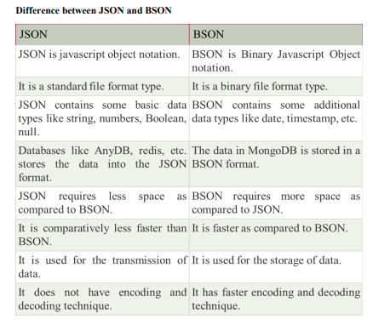

Slide 13
Why to use NoSQL database
To prevent the database from becoming a system-wide bottleneck, especially in high volume environments, NoSQL databases perform in a way that relational databases cannot.
The following features are driving the popularity of NoSQL databases like MongoDB, Couch DB, Cassandra, and HBase:Storing large volumes of data without structure. A NoSQL database doesn’t limit storable data types. Plus, you can add new types as business needs
change.
Using cloud computing and storage. Cloud-based storage is a great solution, but it requires data to be easily spread across multiple servers for scaling. Using affordable hardware on-site for testing and then for production in the cloud is what NoSQL databases are designed for.
Rapid development. If you are developing using modern agile methodologies, a relational database will slow you down. A NoSQL database doesn’t require the level of preparation typically needed for relational databases.

Slide 15
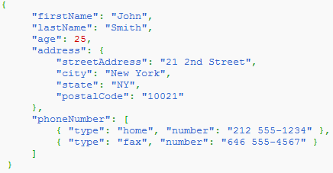

Slide 16
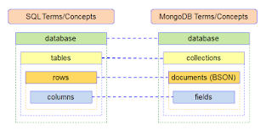

Slide 17
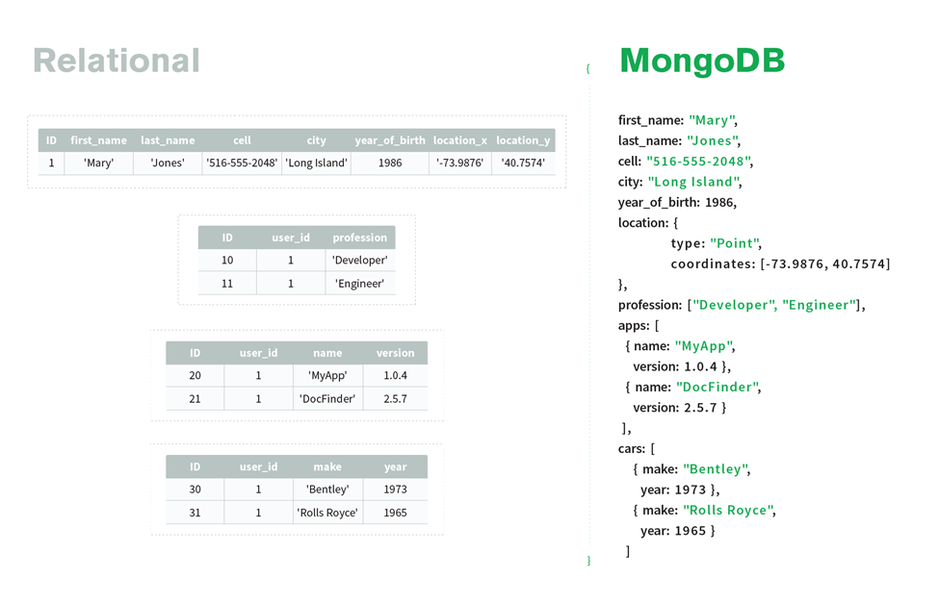

Slide 18
MongoDB supports many datatypes. Some of them are −
•String − This is the most commonly used datatype to store the data. String in MongoDB must be UTF-8 valid.
•Integer − This type is used to store a numerical value. Integer can be 32 bit or 64 bit depending upon your server.
•Boolean − This type is used to store a boolean (true/ false) value.
•Double − This type is used to store floating point values.
•Min/ Max keys − This type is used to compare a value against the lowest and highest BSON elements.
•Arrays − This type is used to store arrays or list or multiple values into one key.
•Timestamp − ctimestamp. This can be handy for recording when a document has been modified or added.
•Object − This datatype is used for embedded documents.
•Null − This type is used to store a Null value.
•Symbol − This datatype is used identically to a string; however, it's generally reserved for languages that use a specific symbol type.
•Date − This datatype is used to store the current date or time in UNIX time format. You can specify your own date time by creating object of Date and passing day, month, year into it.
•Object ID − This datatype is used to store the document’s ID.
•Binary data − This datatype is used to store binary data.
•Code − This datatype is used to store JavaScript code into the document.
•Regular expression − This datatype is used to store regular expression.

Slide 19
COMMANDS:
1. show dbs //displays all databases
2. Use admin //switched to db database_name called admin
3. Use college
4. Show dbs //displays dbs default like: admin, config,local
5. db.createCollection(“students”) //Create Students Database
6. db.dropDatabase() //Removes students Databases
7. db.students.insertOne({name:”Arun”, age: “18”, section: “ITA”}) //insert field into DB
8. db.students.find() //It have a unique Id for Each object
9. db.students.insertMany([ {}, {}, {}])
10. db.students.insertOne({name:”Ramu,
Age: “20”,
address:{H.no: “1-2-3/A”, city: “Hyderabad”, Zip: “500020”}
courses: [“Web Technology”, “JavaScript”, “React”]
})
11. db.students.find().sort({name:1}) //if its -1, sorts in reverse order
12. db.student.find.limit(1) //display 1st record
13. db.students.find.sort({age:-1}).limit(1) //display highest age
14. db.students.updateOne({name:"Arun Kumar"},{$set: {age:"30"}}) //updating age

Slide 20
CRUD Operations
Create Operations
List the databases
>show dbs
If the database exists, switch to the specified database otherwise
create the database.
>use db
To drop database
Db.dropDatabase()
Collections
Create a collection
db.createCollection(<collection-name>);
Also, we don't need to create collection. MongoDB creates collection automatically, when you insert some document
Ex: db.kmit.insert({"name" : “kmitstudent"})
A collection by name kmit will be created to which a document with the data will be added.

Slide 21
To list the collections
>show collections
To drop the collection
Db.collection name.drop()
>db.kmit.drop()
Kmit is a collection name
Documents
Insert a document to collection
> db.COLLECTION_NAME.insert(document)
Ex:db.kmit.insert({"name" : “kmitstudent"})
In the inserted document, if we don't specify the _id parameter, then MongoDB assigns a unique ObjectId for this document

Slide 22
If we want to add the unique id as well -
Ex :-db.kmit.insert( { _id: 10, name : “kmitstudent1"} )
To insert multiple documents at a time
db.empDetails.insertMany(
[
{
First_Name: "Radhika",
Last_Name: "Sharma",
Age: "26",
e_mail: "radhika_sharma.123@gmail.com",
phone: "9000012345"
},
{
First_Name: "Rachel",
Last_Name: "Christopher",
Age: "27",
e_mail: "Rachel_Christopher.123@gmail.com",
phone: "9000054321"
},
])

Slide 23
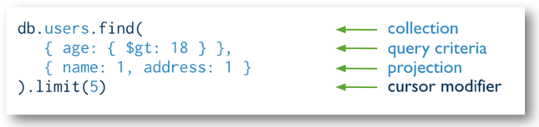
Read operations
Read operations retrieve documents from a collection; i.e. query a
collection for documents
Db.collection.find()

Slide 24
db.Collection_name.find(selection_criteria, projection)
selection_criteria: It specifies selection criteria. To return all documents in a collection use empty document({}). The type of this parameter is document.
projection: It specifies the fields to return in the documents that match the selection criteria. To return all fields in the matching documents, remove this parameter.
Ex: db.books.find() or db.student.find({})
db.student.find({age:18})
Projection - selecting only the necessary data rather than selecting whole of the data of a document.
If a document has 5 fields and we need to show only 3, then select only 3 fields from them basic syntax of find() method with projection is -
db.COLLECTION_NAME.find({},{KEY:1})

Slide 25
_id field is always displayed while executing find() method, if we don't want this field, then we need to set it as 0 –
db.mycol.find({},{_id:0})
If we want a column ‘name’ to be displayed and we do not want id to bedisplayeddb.mycol.find({},{“name":1,_id:0})
findOne() - that returns only one document.
db.COLLECTIONNAME.findOne()
db.mycol.findOne({title: "MongoDB Overview"})
limit() – limits the result.
>db.COLLECTION_NAME.find().limit(NUMBER)
Ex –db.mycol.find({},{“name":1,_id:0}).limit(2)
skip() – is used to skip the number of documents
>db.COLLECTION_NAME.find().limit(NUMBER).skip(NUMBER)
Ex – the following prints only second document
db.mycol.find({},{"title":1,_id:0}).limit(1).skip(1)
sort() – is used sort documents
The method accepts a document containing a list of fields along with their sorting order. To specify sorting order 1 and -1 are used. 1 is used for ascending order while -1 is used for descending order
db.COLLECTION_NAME.find().sort({KEY:1})
db.kmit.find({},{“name":1,_id:0}).sort({“name":-1})

Slide 26
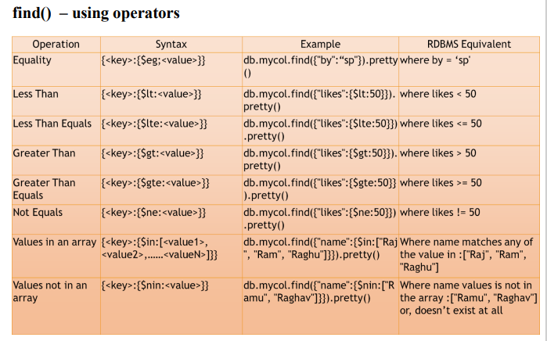

Slide 27
Starts with, Contains
Contains --
db.books.find({"title":{$regex:/h/i}}).pretty()
Starts with -
db.books.find({"title":{$regex:/^h/i}}).pretty()
Ends with:
db. books.find({title : {$regex : /w$/i}})
And - query documents based on the AND condition, you need to use
$and keyword
db.mycol.find({
$and: [
{<key1>:<value1>}, { <key2>:<value2>}
]
})
And - query documents based on the AND condition, you need to use
$and keyword
db.mycol.find({ $and: [ {<key1>:<value1>}, { <key2>:<value2>} ]
})
Ex: - db.kmitmore.find({$and: [{branch: "CSE"},
{joiningYear: 2018}]}).pretty()

Slide 28
A little tricky –db.kmitmore.find({$and: [{$or: [{branch: "ECE"},
{joiningYear: 2017}]},
{$or: [{"personal.state": "UP"},
{"personal.age": 25}]}]}).pretty()
OR in MongoDB
db.mycol.find(
{
$or: [
{key1: value1}, {key2:value2}
]}).pretty()
Pretty method -db.COLLECTION_NAME.find().pretty()retrieves all the documents from the collection and arranges them in an easy-to-read format.
Nor – not -need to use $not keyword
db.COLLECTION_NAME.find(
{
$not: [
{key1: value1}, {key2:value2}
]
}
)

Slide 29
Update operations
Update- update operations target a single collection
To update only one document
db.collection.updateOne()
To update multiple documents at a time
db.collection.updateMany()
To replace existing document with new document
db.collection.replaceOne()
FindAndModify and Update, with upsertUsing Update -
db.student.findAndModify({query:{name:"Jack"},
update:{$set:{address:"Australia"}},
upsert:true})
If a student by name Jack exists then it will update the document, else it will insert a new document, because upsert if set to true.
Using Update -
db.employee.update({name:“John"}, {$set: {department:
"HR"}},{upsert:true})

Slide 30
Delete operations
Delete - Delete operations remove documents from a collection.
db.collection.deleteOne()
db.collection.deleteMany()

Slide 31
What is Mongoose used for?
Mongoose is a MongoDB ODM i.e (Object database Modelling) that used to translate the code and its representation from MongoDB to the Node. js server
INSTALLING MONGOOSE WITH NPM:
Npm install mongoose
Importing mongoose module :
Const mongoose = require(‘mongoose’)
CONNECTING TO MONGODB:
mongoose.connect("mongodb://localhost:27017/myDB");

Slide 32
Match n project :-
[ { $match: { tags:"enim" } }]
[ { $match: { tags: "enim", }, }, { $count:'userwithenim' }]
[ { $match: { isActive:false, tags:"enim" }, }]
[ { $match: { isActive:false, tags:"enim" }, }, { $project: { name:1, age:1, } }]
Lookup:
[ { $lookup: { from: "authors", localField: "author_id", foreignField: "_id", as:"author_details" } } ]
Addfield
[ { $lookup: { from: "authors", localField: "author_id", foreignField: "_id", as:"author_details" } }, { $addFields: { author_details:{ $arrayElemAt:["$author_details",0] } } } ]

Slide 33
Project
[{ $match: { isActive:false,tags:"enim" }}, { $project: { name:1, age:1 } }]
[{ $project: { customer: 1, total_amount: 1 }}
Total sum:-
[ { $group: { _id: null, totalSales: { $sum: "$total_amount" } } }]
[ { $group: { _id: "$customer", totalSales: { $sum: "$total_amount" } } }, { $limit: 1 }]

Slide 34
[ { $addFields: { discount: { $cond: { if: { $gte: ["$total_amount", 150] }, then: 0.1, else: 0 } } } } ]
[ { $lookup: { from: "customer", localField: "customer", foreignField: "name", as: "result" } }]
[ { $count: "total_orders" }]

Slide 35
Sample Database for Aggregate Pipeline:-
Collection name:-order
[{
"_id": 1,
"customer": "Alice",
"total_amount": 100,
"\"order_date\"": "ISODate(\"2023-01-01T12:00:00Z\")",
"\"author_id\"": "100"
},
{
"_id": 2,
"customer": "Bob",
"order_date": 25092023,
"total_amount": 150,
"\"order_date\"": "ISODate(\"2023-01-02T14:30:00Z\")",
"\"author_id\"": "101"
},
{
"_id": 3,
"customer": "Alice",
"order_date": 12032023,
"total_amount": 200,
"\"order_date\"": "ISODate(\"2023-01-03T10:45:00Z\")",
"\"author_id\"": "102"
}]

Slide 36
calculate the total sales amount for each customer. You can use the aggregate pipeline for this:
$group:-This aggregation stage groups documents by the unique _id expression provided.
[ {
$group: {
_id: "$customer",
totalSales: { $sum: "$total_amount" }
}
}
]
Explanation of the pipeline stages:
$group: Groups the documents by the "customer" field.
$sum: Calculates the sum of the "total_amount" field for each group.
The result of this aggregation will be:
{ "_id" : "Bob", "totalSales" : 150 }
{ "_id" : "Alice", "totalSales" : 300 }
This result shows the total sales amount for each customer.

Slide 37
$limit (aggregation)
Limits the number of documents passed to the next stage in the pipeline.
Syntax
The $limit stage has the following prototype form:
{ $limit: <positive 64-bit integer> }
$limit takes a positive integer that specifies the maximum number of documents to pass along.
Behavior
Using $limit with Sorted Results
If using the $limit stage with any of:
• the $sort aggregation stage,
• the sort() method,
Example:-
db.orders.aggregate([
{ $limit: 2 }
])
This will return the first 2 documents from the "orders" collection.

Slide 38
$project
Definition
Passes along the documents with the requested fields to the next stage in the pipeline. The specified fields can be existing fields from the input documents or newly computed fields.
Syntax
The $project stage has the following prototype form:
{ $project: { <specification(s)> } }
The $project takes a document that can specify the inclusion of fields, the suppression of the _id field, the addition of new fields, and the resetting of the values of existing fields. Alternatively, you may specify the exclusion of fields.
$project: Reshapes documents, including or excluding fields.
[
{ $project: {
customer: 1,
total_amount: 1,
}
}
]

Slide 39
$addFields (aggregation)
Adds new fields to documents. $addFields outputs documents that contain all existing fields from the input documents and newly added fields.
The $addFields stage is equivalent to a $project stage that explicitly specifies all existing fields in the input documents and adds the new fields.
Syntax
The stage has the following syntax:
{ $addFields: { <newField>: <expression>, ... } }
Behavior
•$addFields appends new fields to existing documents. You can include one or more $addFields stages in an aggregation operation.
•$addFields accepts the embedding of objects where you can set a value to an aggregation expression or to an empty object. For example, the following nested objects are accepted:
{$addFields: { a: { b: { } } } }

Slide 40
db.orders.aggregate([
{
$addFields: {
discount: {
$cond: {
if: { $gte: ["$total_amount", 150] },
then: 0.1,
else: 0
}
}
}
}
])

Slide 41
$lookup (aggregation)
Performs a left outer join to a collection in the same database to filter in documents from the "joined" collection for processing.
db.orders.aggregate([
{
$lookup: {
from: "customers",
localField: "customer", (from current table)
foreignField: "name", (from another table)
as: "customer_info"
}
}
])
there's a "customers" collection with a "name" field, this stage will join "orders" with "customers" based on the "customer" field.

Slide 42
$count (aggregation)
Passes a document to the next stage that contains a count of the number of documents input to the stage.
Syntax
$count has the following prototype form:
{ $count: <string> }
<string> is the name of the output field which has the count as its value.
db.orders.aggregate([
{ $count: "total_orders" }
])
This will return a single document with the field "total_orders" indicating the count.

Slide 43
$sort: Sorts the documents in the pipeline.
Sorts all input documents and returns them to the pipeline in sorted order.
Syntax
The $sort stage has the following prototype form:
{ $sort: { <field1>: <sort order>, <field2>: <sort order> ... } }
If sorting on multiple fields, sort order is evaluated from left to right.
Value Description
1 Sort ascending.
-1 Sort descending.
db.orders.aggregate([
{ $sort: { total_amount: -1 } }
])
This will sort the documents in descending order based on the "total_amount" field.

Slide 44
$match
This aggregation stage behaves like a find. It will filter documents that match the query provided.
Example:-
[ { $match: { customer : "Alice" } }]

